Slide 1
BT-7: Magnetic scattering in Ferromagnetic La_{0.7}Sr_{0.3}MnO₃
David Lioi, Mitchell Bordelon, Kannan Lu,
Heda Zhang, Sharon S Philip, and Yuan Bo
NIST Center for Neutron Scattering
Summer School 2017

Slide 2
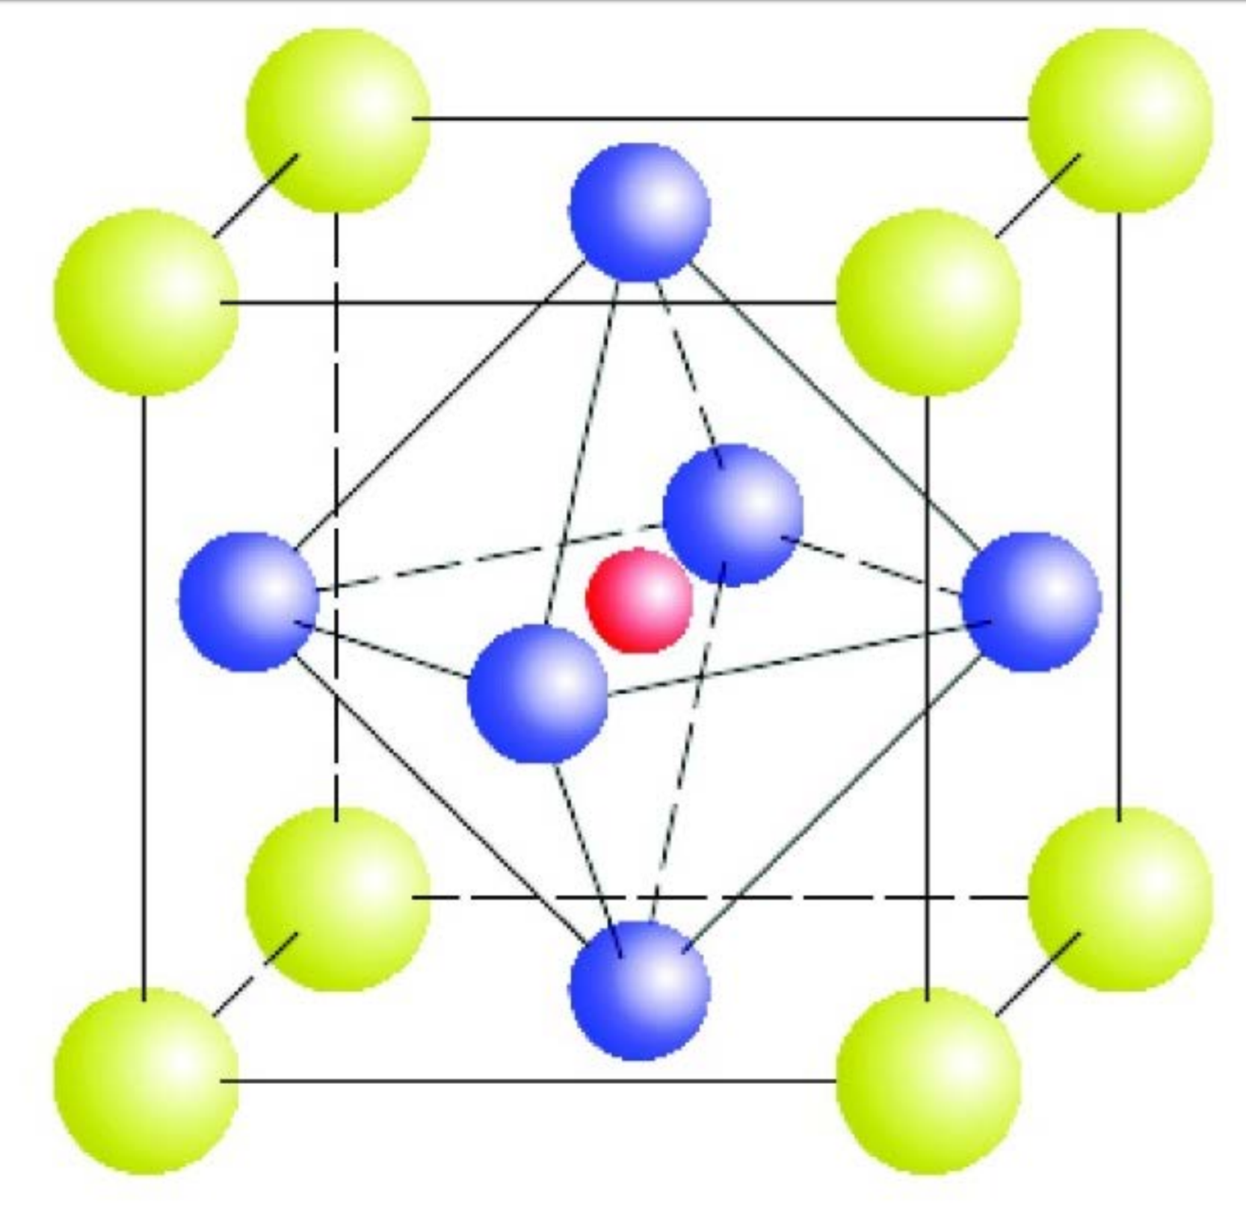
(La³⁺)(Mn³⁺)O₃ and (Sr²⁺)(Mn⁴⁺)O₃
e_{g}
Δ_{o}
t_{2g}
Mn³⁺
AFM insulator
Mn⁴⁺
FM conductor
O²⁻
Mn³⁺
Mn³⁺
Zhao, Y.; Xu, Z.; Ratcliff, W.; Lynn, J. Magnetic Phase Transition and Spin Wave Excitations in the Colossal Magnetoresistive Manganites: An Experiment Using the BT7 Triple-Axis Spectrometer. NIST NCNR (2017).
Notes:
2d space integral over local magnetization
Magnetization field that begins orthonorm to plane and slowly turns over
Minimized with a circular orientation

Slide 3
(La³⁺)(Mn³⁺)O₃ and (Sr²⁺)(Mn⁴⁺)O₃
e_{g}
Δ_{o}
t_{2g}
Mn³⁺
AFM insulator
Mn⁴⁺
FM conductor
O²⁻
Mn³⁺
Mn⁴⁺
Zhao, Y.; Xu, Z.; Ratcliff, W.; Lynn, J. Magnetic Phase Transition and Spin Wave Excitations in the Colossal Magnetoresistive Manganites: An Experiment Using the BT7 Triple-Axis Spectrometer. NIST NCNR (2017).
Notes:
2d space integral over local magnetization
Magnetization field that begins orthonorm to plane and slowly turns over
Minimized with a circular orientation

Slide 4
(La³⁺)(Mn³⁺)O₃ and (Sr²⁺)(Mn⁴⁺)O₃
e_{g}
Δ_{o}
t_{2g}
Mn³⁺
AFM insulator
Mn⁴⁺
FM conductor
Charge, exchange, and geometry drive magnetic order
O²⁻
Mn³⁺
Mn⁴⁺
Zhao, Y.; Xu, Z.; Ratcliff, W.; Lynn, J. Magnetic Phase Transition and Spin Wave Excitations in the Colossal Magnetoresistive Manganites: An Experiment Using the BT7 Triple-Axis Spectrometer. NIST NCNR (2017).
Notes:
2d space integral over local magnetization
Magnetization field that begins orthonorm to plane and slowly turns over
Minimized with a circular orientation

Slide 5
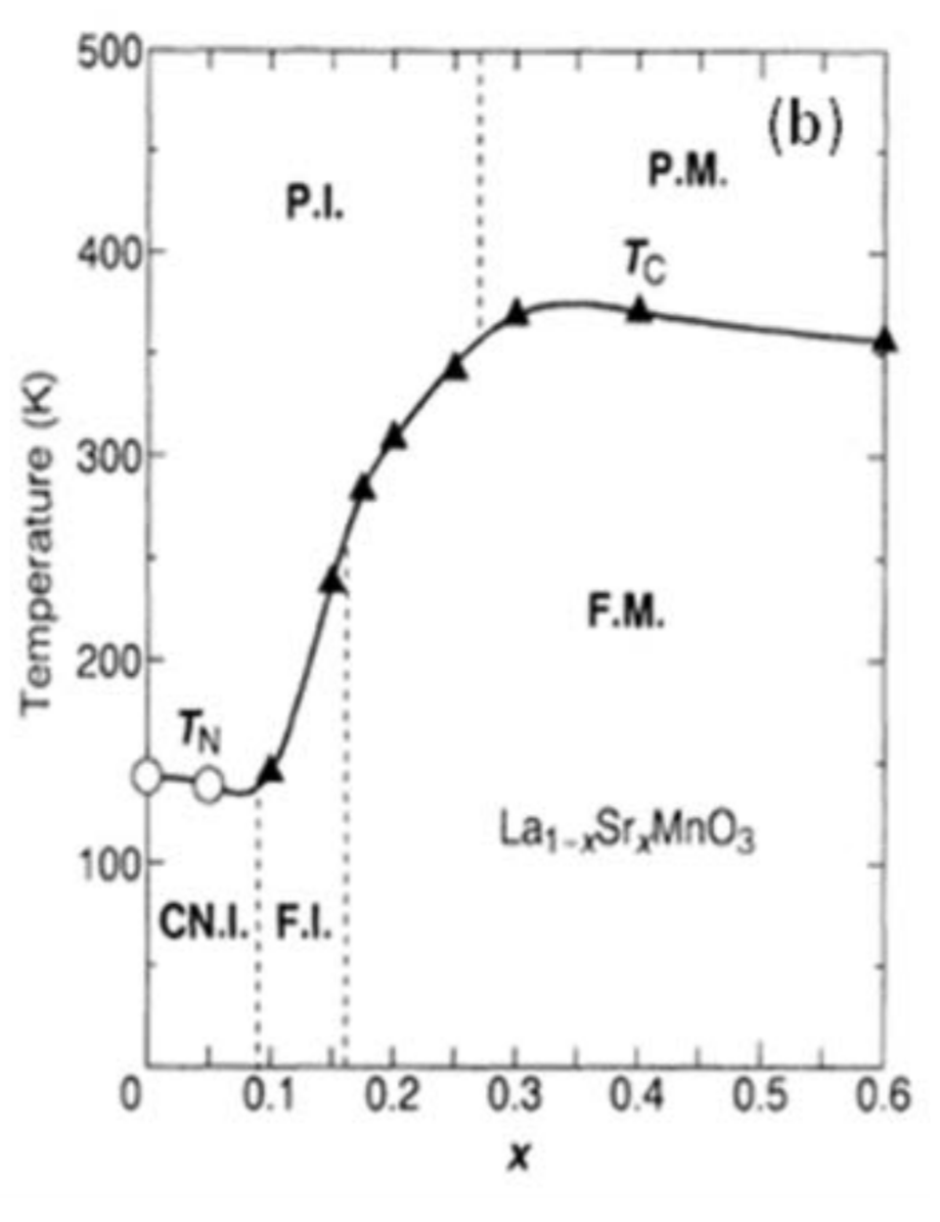
La_{1-x}Sr_{x}MnO₃ at x=0.3
FM accompanies metal-insulator transition
Control with magnetic field
Colossal magnetoresistance
Resistivity change in magnetic field
Sample of interest:
La_{0.7}Sr_{0.3}MnO₃
Insulator-Metal transition and giant magnetoresistance in La_{1-x}Sr_{x}MnO₃, A. Urushibara, Y. Motitomo, T. Arima, A. Asamitsu, G. and Y. Tokura, Phys. Rev. B 51, 14103 (1995)
Notes:
2d space integral over local magnetization
Magnetization field that begins orthonorm to plane and slowly turns over
Minimized with a circular orientation

Slide 6
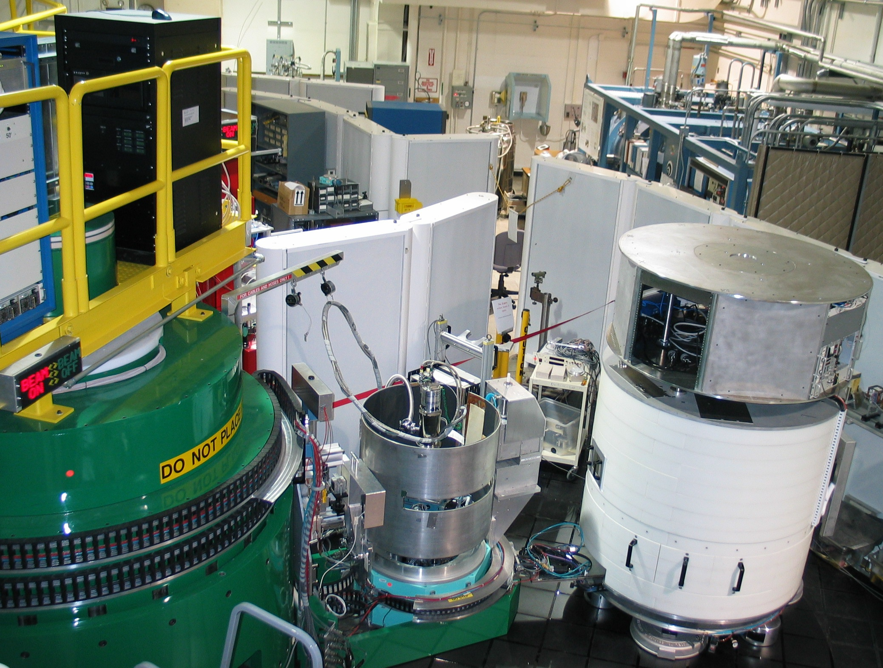
BT-7 triple axis spectrometer
https://www.ncnr.nist.gov/instruments/bt7_new/PhotosofBT-7.html
Notes:
2d space integral over local magnetization
Magnetization field that begins orthonorm to plane and slowly turns over
Minimized with a circular orientation

Slide 7
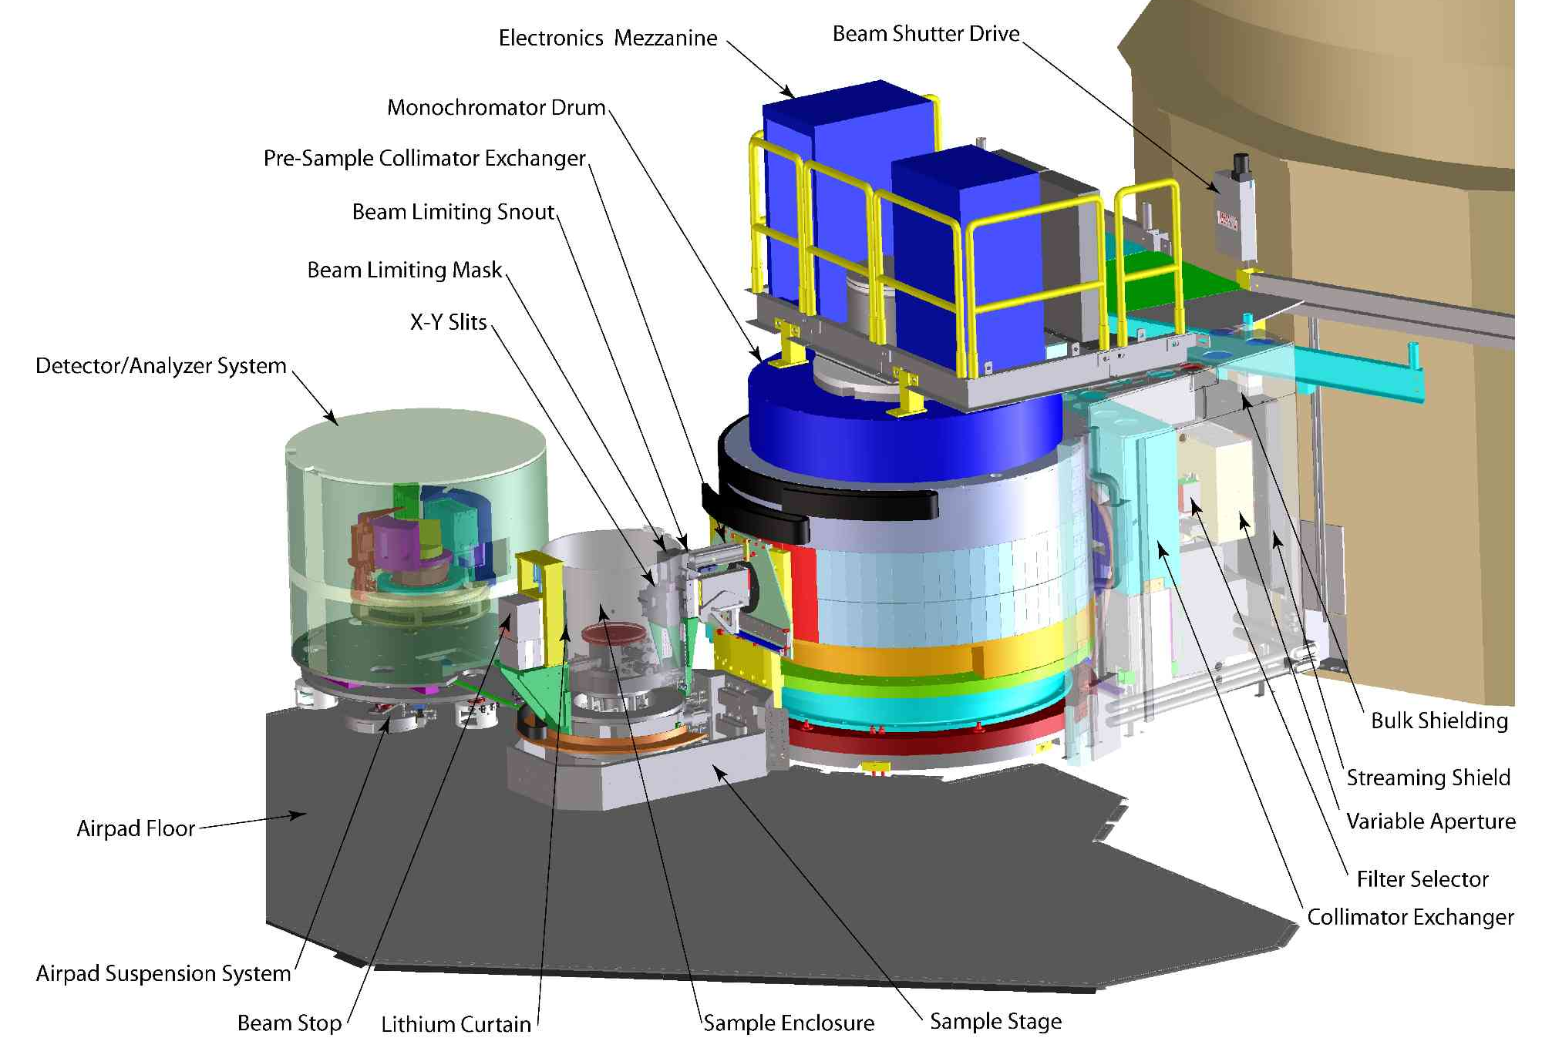
BT-7 triple axis spectrometer
https://www.ncnr.nist.gov/instruments/bt7_new/
Notes:
2d space integral over local magnetization
Magnetization field that begins orthonorm to plane and slowly turns over
Minimized with a circular orientation

Slide 8
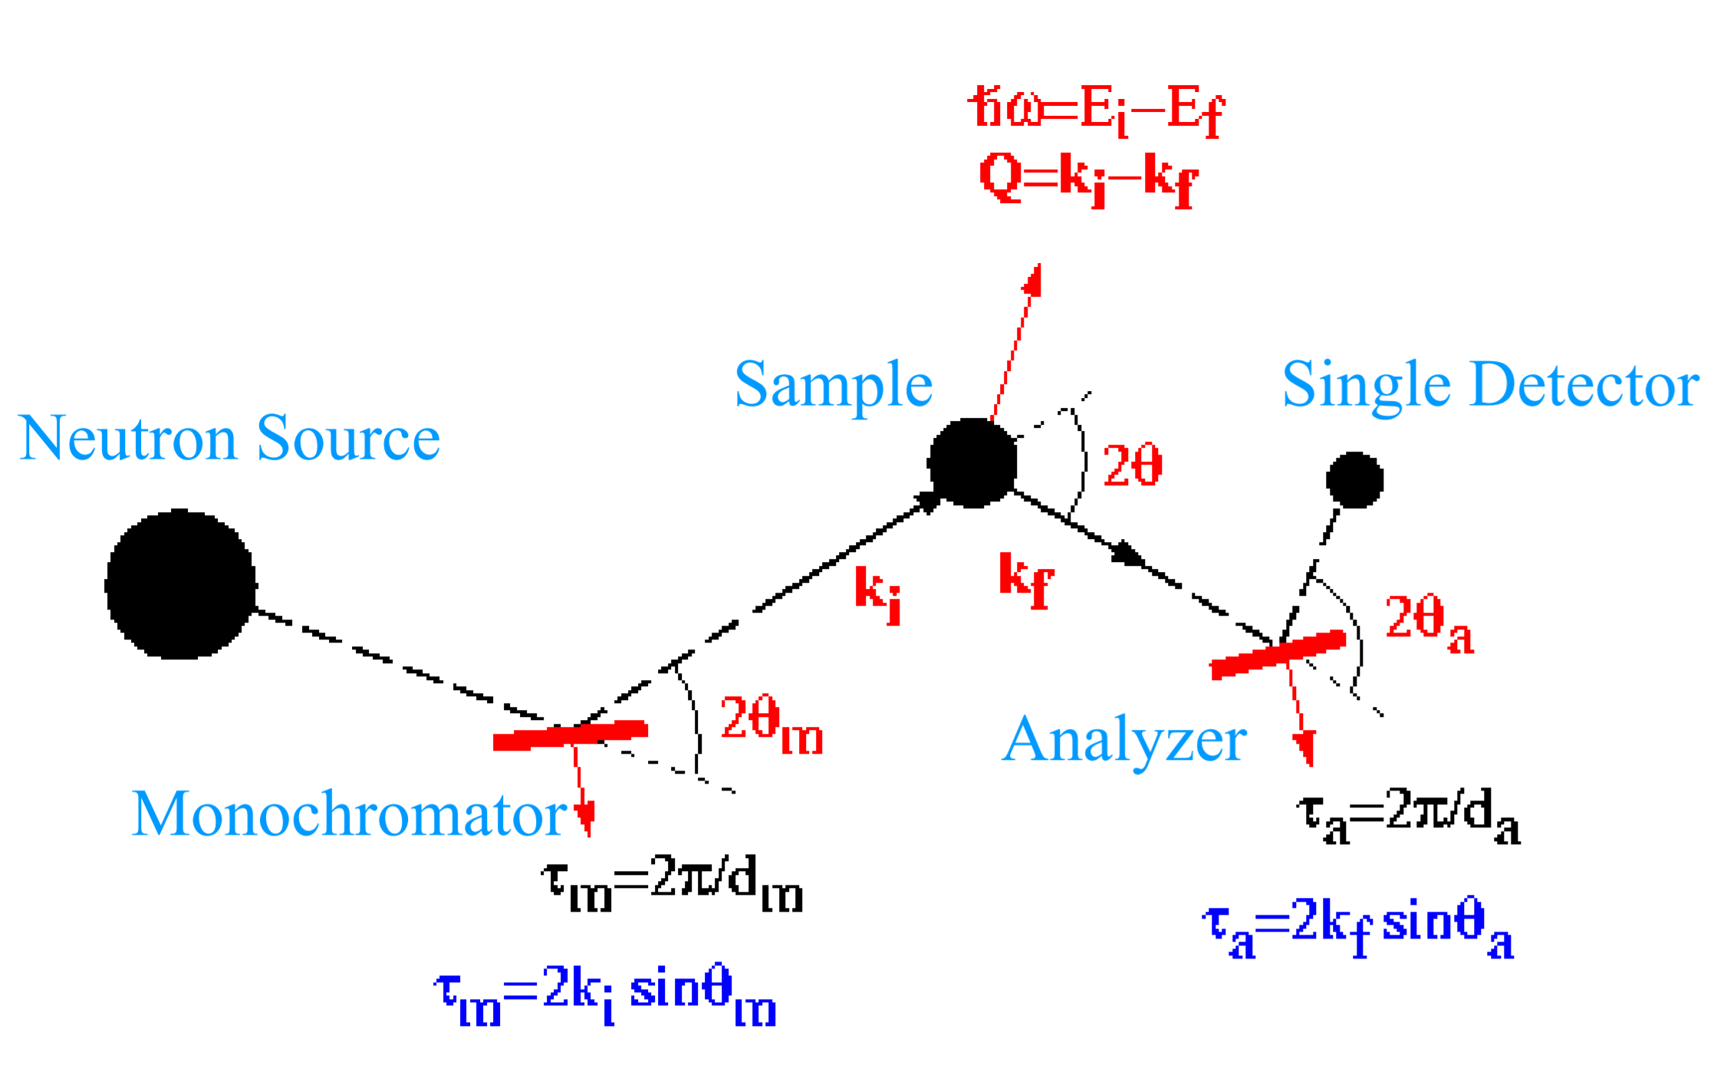
BT-7 triple axis spectrometer
TAS is ideally suited for probing small regions in k-space while varying an environmental parameter
(like temperature)
https://www.ncnr.nist.gov/instruments/bt7_new/PhotosofBT-7.html
Notes:
2d space integral over local magnetization
Magnetization field that begins orthonorm to plane and slowly turns over
Minimized with a circular orientation

Slide 9
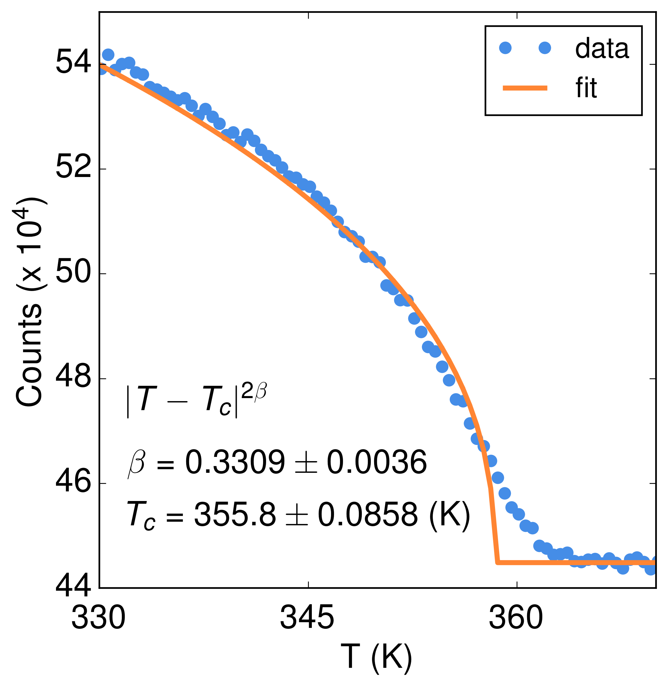
Picking the E-k-space of Interest
T vs. Bragg peak intensity
Monitor magnetism with temperature
Align the crystal
Assess the strength of the magnetic order parameter
Extract useful physical constants
Magnetic Order Parameter
Critical
Fluctuations
Notes:
2d space integral over local magnetization
Magnetization field that begins orthonorm to plane and slowly turns over
Minimized with a circular orientation

Slide 10
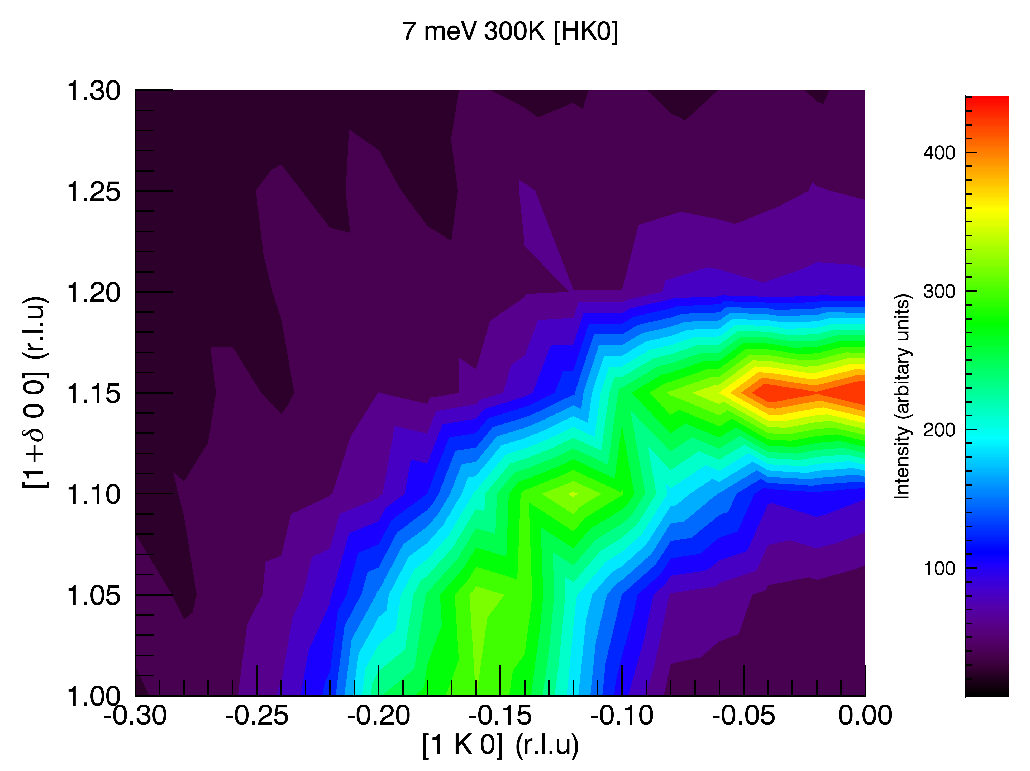
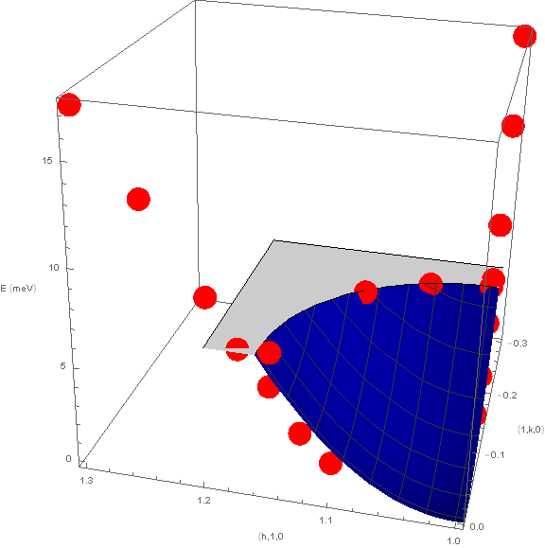
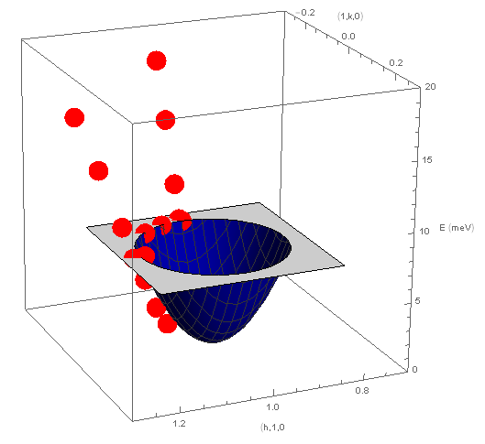
Mapping out E-k-space of Interest
Inelastic scattering when Energy Transfer: E>0
Elastic scattering when energy transfer E=0
Notes:
2d space integral over local magnetization
Magnetization field that begins orthonorm to plane and slowly turns over
Minimized with a circular orientation

Slide 11
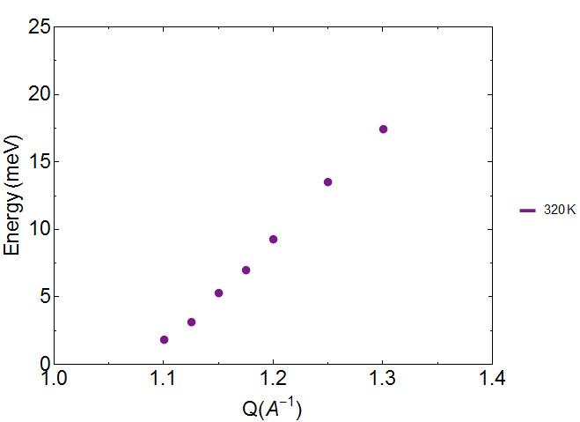
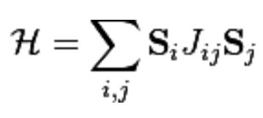
Model the Magnetic Dispersion
JS= -3.56 meV
Plot the dispersion curve at each temperature
E=8|SJ|sin²(qa/2)~2|SJ|a²q²
Fit the experimental magnetic dispersion to the theoretical model in “SpinW” to extract the spin: J
Notes:
2d space integral over local magnetization
Magnetization field that begins orthonorm to plane and slowly turns over
Minimized with a circular orientation

Slide 12
Acknowledgements
We in Group 2 would like to thank the scientists and staff at BT7 and at NCNR in general for putting on this school
Notes:
2d space integral over local magnetization
Magnetization field that begins orthonorm to plane and slowly turns over
Minimized with a circular orientation

